Slide 1
A simulation study to assess the performance of the unpaired t-test assuming equal variances
Group 7

Slide 2
Data-generating mechanisms
We used R
We set the seed once at the beginning (before the loop)
We simulated data for n_{obs} = 250 each in 2 equally-sized groups, n_{reps} = 500
We used 2 DGMs:
DGM 1 followed a Poisson distribution (λ = 1)
DGM 2 followed a normal distribution (mean = 0, SD = 1)
Estimand: difference in means

Slide 3
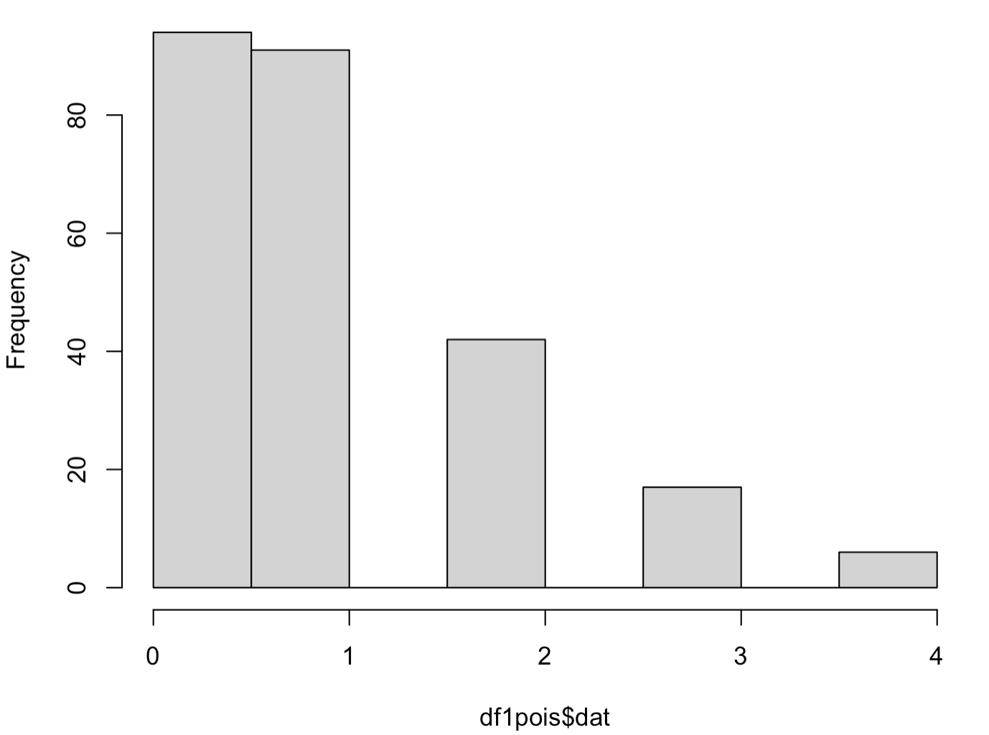
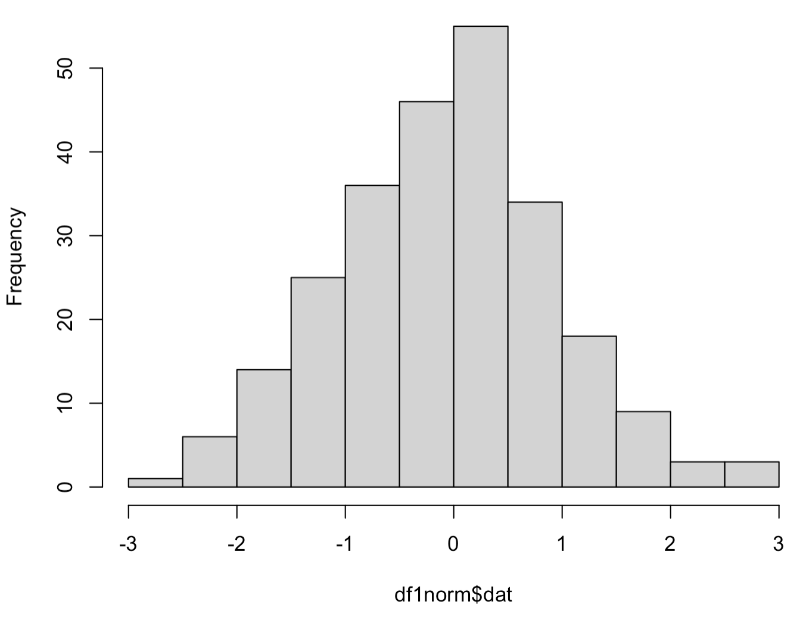
Poisson data not normally distributed (good)
Normally distributed data normally distributed (good)

Slide 4
Method of analysis
We used 1 method: unpaired t-test assuming equal variances
Implemented in R using t.test(var ~ groupingvar, data=data, var.equal=TRUE, paired=FALSE)
This test is easy to implement and quick to conduct, is it biased if its assumptions are violated?

Slide 5
Performance measures
We used rsimsum to assess performance for each DGM
We evaluated empirical and model-based SE, coverage, power and respective MCSE for each
Sanity check:
Plots of theta hat distribution and SE theta hat vs theta hat for each DGM

Slide 6
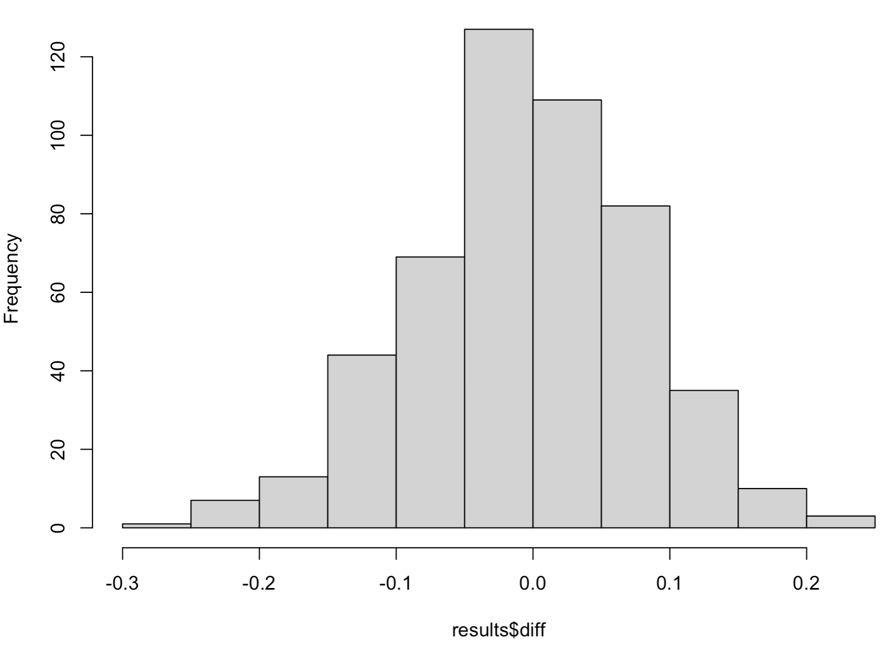
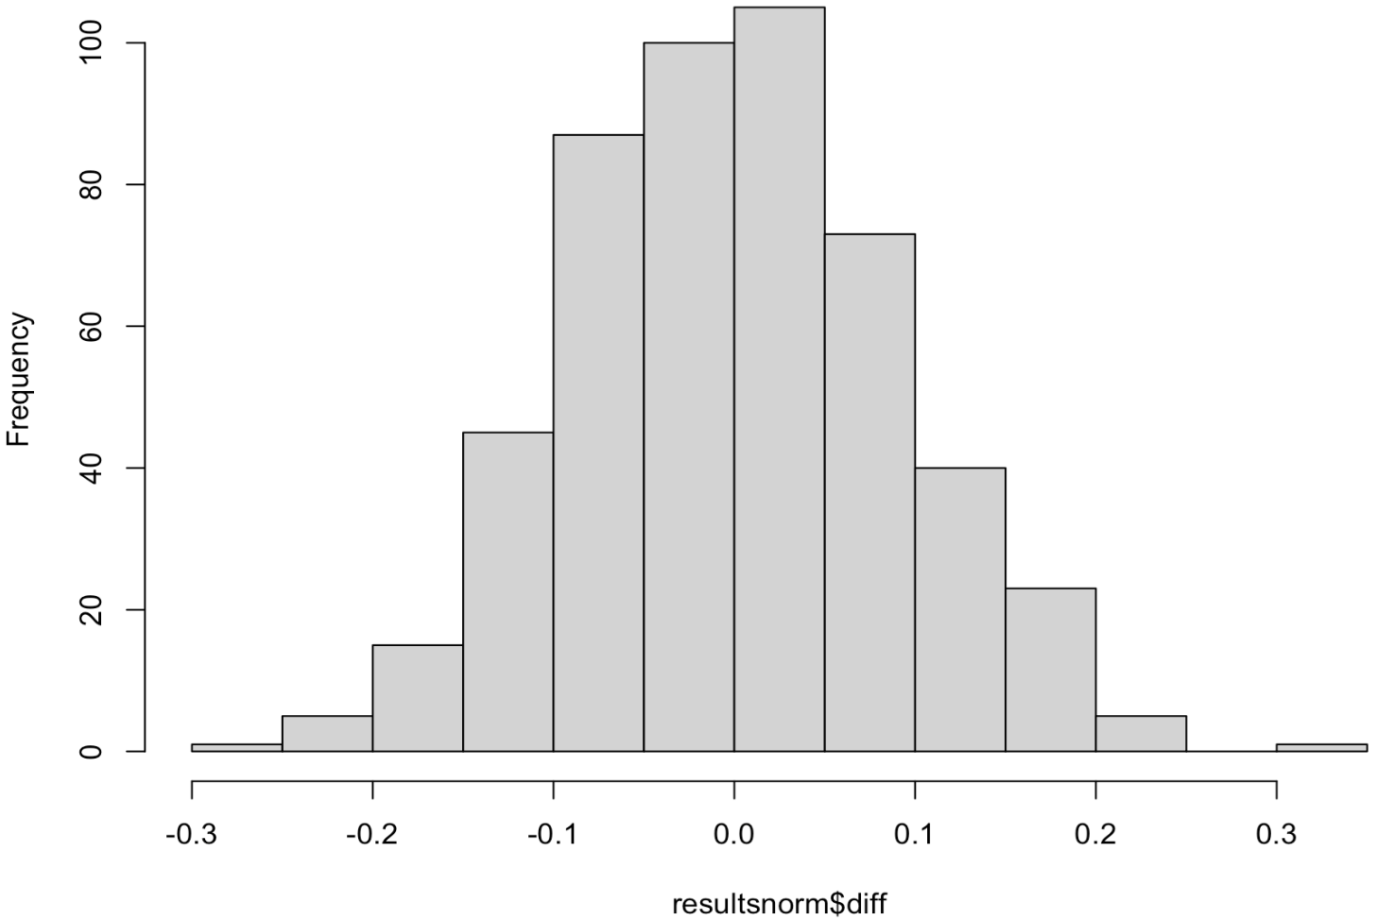
Distribution of theta hat for DGMs 1/2 – no obvious outliers that could drive bias/unusual empirical SE

Slide 7
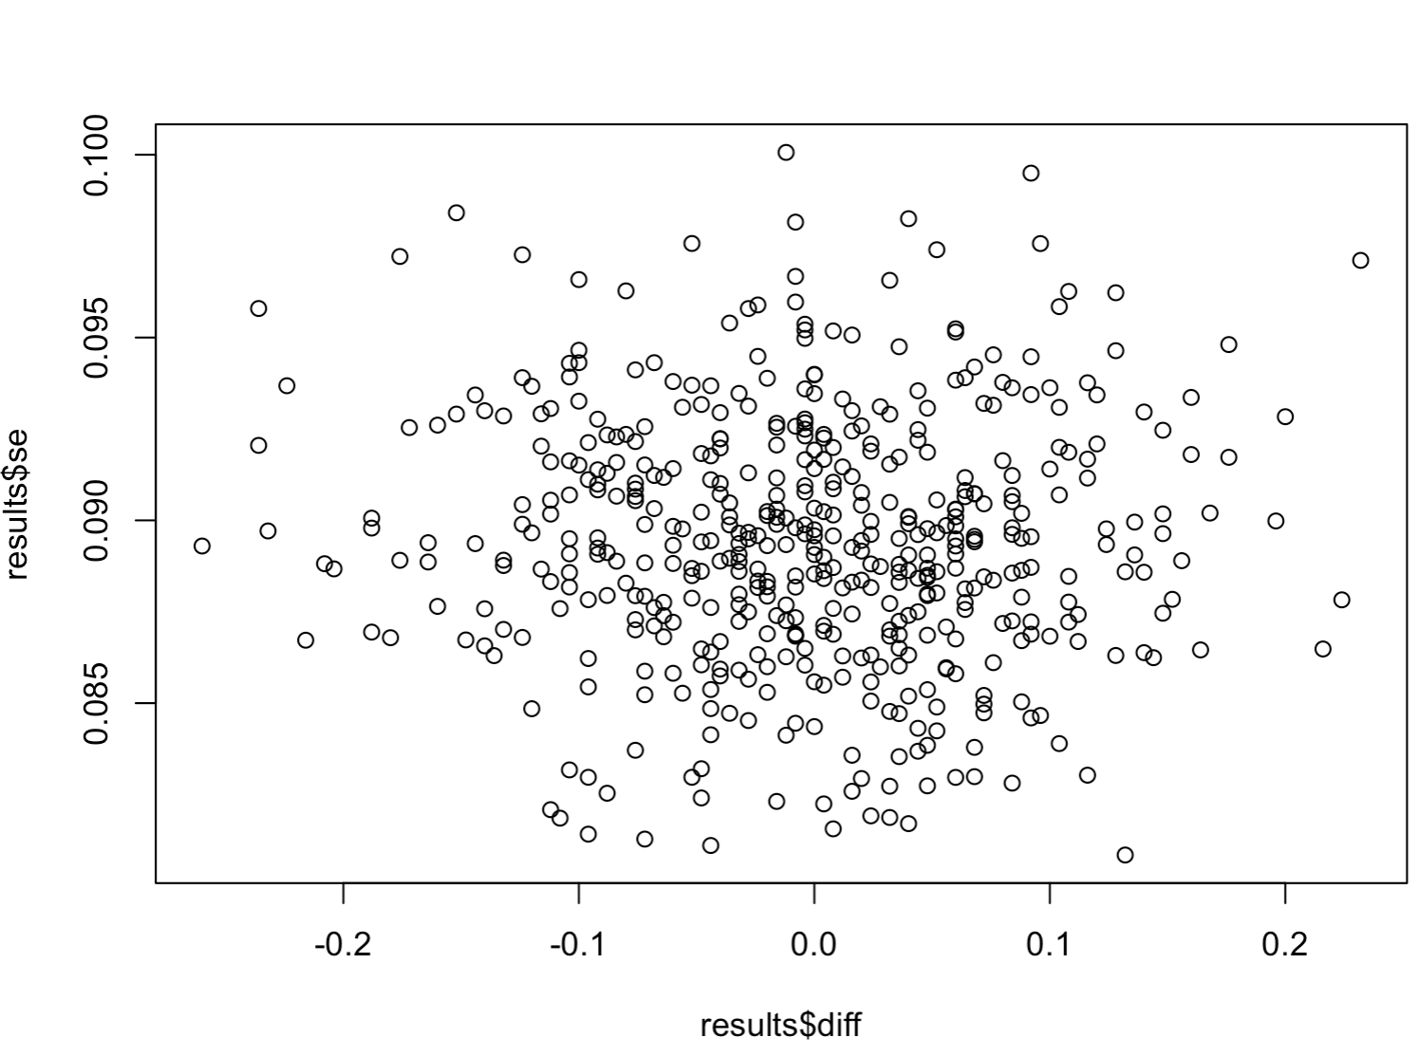
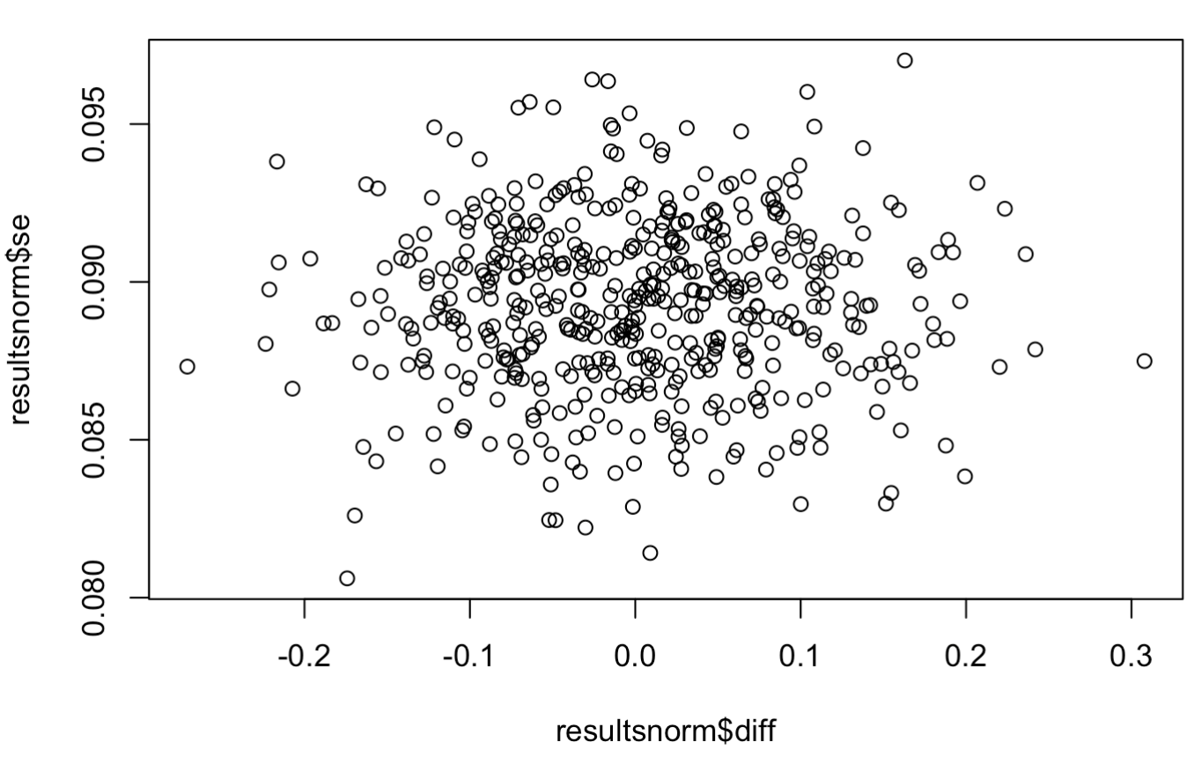
SE of theta hat vs theta hat for DGMs 1/2 – again no obvious outliers driving SE

Slide 8
DGM | Bias (MCSE) | Emp SE | Mod SE | Coverage | Power
1 (Poisson) | -0.0055 (0.004) | 0.0879 (0.003) | 0.0894 (0.0002) | 0.9540 (0.0094) | 0.0460 (0.0094)
2 (normal) | 0.0011 (0.004) | 0.0903 (0.003) | 0.0893 (0.0001) | 0.9480 (0.01) | 0.0520 (0.01)
Bias greater for Poisson (to be expected)
Empirical and model SEs very similar– empirical < model is better
Coverage fine – unsurprising as there is a lack of bias and low model SE

Slide 9

If we had more time:
Store diagnostics from each rep of the DGM within the loop (mean for each group, correlation between groups?)
See what happens when you have unequally-sized groups
Try an additional method: paired t-test/one not assuming equal variances
Code available at: https://github.com/aaronmitchell1/UCLsimcourse
MRC Integrative Epidemiology Unit
@MRC_IEU
bristol.ac.uk/integrative-epidemiology

